Slide 1
LESSON 17: Raising Lazarus The Life Of Christ – Perea to Bethany
John 11:1-57
December 15, 2021

Slide 2
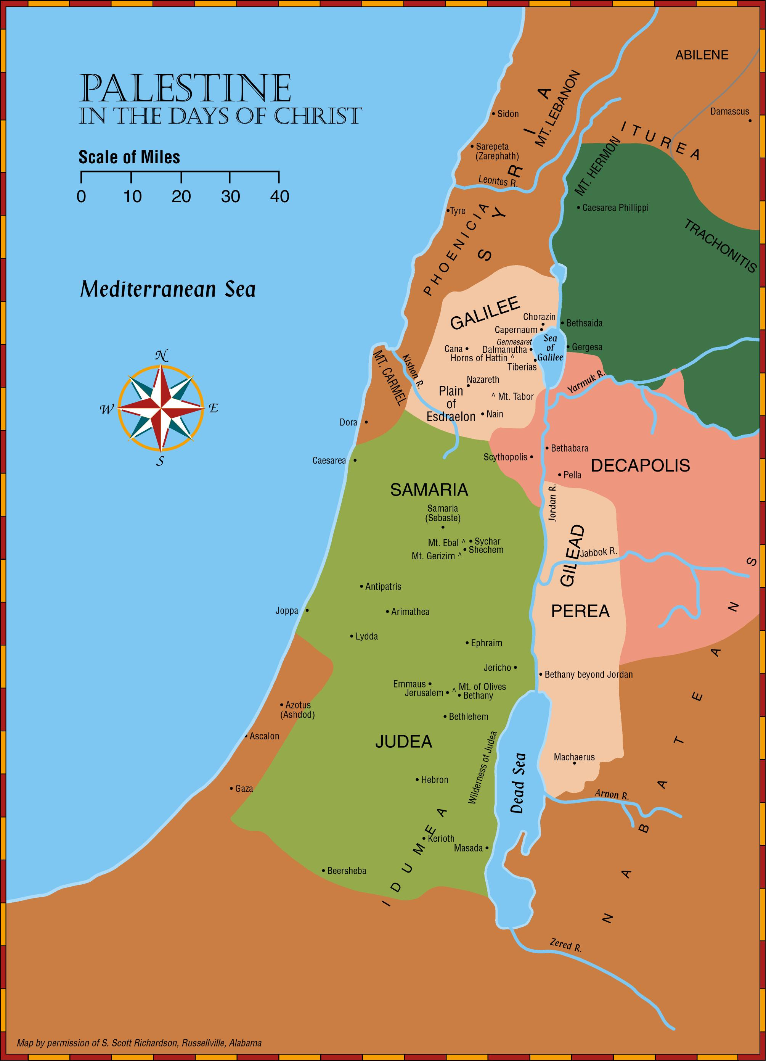
Perea
Includes the narrow strip of land that once belonged to the tribes of Reuben and Gad
Comes from the Greek word meaning “beyond”
Perea is the land “beyond” the Jordan (Mark 3:8)
Called Gilead in the Old Testament
Jesus withdrew to Perea a few weeks before his crucifixion (John 10:40-42)
John baptized in Bethany beyond Jordan (John 1:28)

Slide 3
The Raising of Lazarus John 11:23-57
A. In this chapter Jesus performed one of the most outstanding miracles of His ministry. He raised Lazarus from the dead.
1. The purpose of His miracles was “that ye might believe that Jesus is the Christ the Son of God, and that believing ye might have life in his name.” (John 20:30-31)

Slide 4
The Raising of Lazarus John 11:23-57
B. After Jesus received word that Lazarus was sick, He tarried for two more days.
1. Four days after Lazarus died, Jesus arrived in Bethany. Martha met Jesus and said, “Lord, if thou hadst been here, my brother had not died …”
a. Martha was not being critical of the Lord, but acknowledging that Jesus had the power to prevent Lazarus’ death.
b. Martha was told that Lazarus shall rise.
(1) She acknowledged that Lazarus would come forth in the resurrection. (cf. John 5:28-29;6:39-40, 54; John 12:48)
(2) Jesus spoke to her about raising Lazarus from the dead miraculously.

Slide 5
The Raising of Lazarus John 11:23-53
Jesus replied that Lazarus would live again.
John 11:23-26, “Jesus saith unto her, Thy brother shall rise again. Martha saith unto him, I know that he shall rise again in the resurrection at the last day. Jesus said unto her, I am the resurrection, and the life: he that believeth on me, though he die, yet shall he live; and whosoever liveth and believeth on me shall never die. Believest thou this?”
Martha understood the words of Jesus to apply to the general resurrection of all “at the last day” (cf. John 5:28-29; 6:39-40,54; 12:48; cf. Mark 12:18; Acts 23:8).
Martha obviously did not expect Jesus to raise Lazarus from the dead immediately. (cf. verse 39)
Jesus talks in verse 25 of physical death (“though he were dead”) and spiritual life (“yet shall he live”), and in verse 26 of physical life (“liveth and believeth”) and spiritual death (“shall never die”).
“I am the resurrection and the life.” (cf. John 10:36; 14:6)
cf. Philippians 1:21; 2 Corinthians 4:16-5:1

Slide 6
The Raising of Lazarus John 11:23-53
Jesus replied that Lazarus would live again.
John 11:23-26, “Believest thou this?”
NOTE: Verse 27, “She saith unto him, Yea, Lord: I have believed that thou art the Christ, the Son of God, (even) he that cometh into the world.”
Not only could Jesus raise Lazarus from physical death, thus giving assurance that he can raise all men from the dead, but Jesus could provide spiritual life.
Whosoever believes in Him shall never die.
(cf. John 3:16)
How can we “live and believe?”
Certainly, this involves more than faith “ONLY.” (cf. John 12:42-43)
Involves obedient faith. (James 2:14-26; Romans 6:16-18; Hebrews 5:8-9)

Slide 7
Lazarus Is Raised From The Dead. John 11:25-46
Jesus converses with Martha and Mary. John 11:27-32, “She saith unto him, Yea, Lord: I have believed that thou art the Christ, the Son of God, (even) he that cometh into the world. And when she had said this, she went away, and called Mary her sister secretly, saying, The Teacher is here, and calleth thee. And she, when she heard it, arose quickly, and went unto him. (Now Jesus was not yet come into the village, but was still in the place where Martha met him.) The Jews then who were with her in the house, and were consoling her, when they saw Mary, that she rose up quickly and went out, followed her, supposing that she was going unto the tomb to weep there. Mary therefore, when she came where Jesus was, and saw him, fell down at his feet, saying unto him, Lord, if thou hadst been here, my brother had not died.”
In verse 32 Mary expresses the same confidence in the Lord that has been expressed by Martha in verse 21.
Neither of these sisters are critical of Jesus nor do they suggest that Jesus should raise him from the dead.

Slide 8
Lazarus Is Raised From The Dead. John 11:25-46
“I am the resurrection and the life.” Jesus has power over death. He has power to give life.
Jesus has power over Satan. When Jesus came forth from the dead, He destroyed the power of death and Satan. (cf. Hebrews 2:14-15)
cf. John 14:6 Jesus is the way to have life. No other way. Not through Mohammad, or through any latter day revelation. Only through knowing the truth, may we have life everlasting. (John 8:32)
Jesus has said, “He that believeth on me, though he die, yet shall he live.” (John 11:25)
Verses 26-27, “Believest thou this?” This involves more than just mental assent.
This involves obedience. (cf. John 12:42-43; cf. James 2:14-16; Romans 6:17-18; Hebrews 5:8-9)

Slide 9
Lazarus Is Raised From The Dead. John 11:25-46
Jesus “groaned in the spirit,” and “Jesus wept.” John 11:33-36, “When Jesus therefore saw her weeping, and the Jews (also) weeping who came with her, he groaned in the spirit, and was troubled, and said, Where have ye laid him? They say unto him, Lord, come and see. Jesus wept. The Jews therefore said, Behold how he loved him!”
Here we see evidence of the humanity of Jesus. He expressed tender sympathy at the death of Lazarus.
Those who know the deep sorrow that is experienced at the death of a loved one can find comfort in knowing that the Lord understands (Hebrews 2:17-18; 4:15-16). Other references to the Lord weeping are found at Luke19:41 and Hebrews 5:7.
Also, He will bring again those who “sleep in Jesus.” (1 Thessalonians 4:13-18).
He never promised we will not suffer tragedy, but He has promised He cares. (Hebrews 13:5; 1 Peter 5:7)

Slide 10
Lazarus Is Raised From The Dead. John 11:25-46
Certainly, the ridicule of some of the Jews also caused Jesus to groan within Himself.
John 11:37-40, “But some of them said, Could not this man, who opened the eyes of him that was blind, have caused that this man also should not die? Jesus therefore again groaning in himself cometh to the tomb. Now it was a cave, and a stone lay against it. Jesus saith, Take ye away the stone. Martha, the sister of him that was dead, saith unto him, Lord, by this time the body decayeth; for he hath been (dead) four days. Jesus saith unto her, Said I not unto thee, that, if thou believedst, thou shouldest see the glory of God?” (cf. 11:4, 23ff)
Yes, Jesus could have prevented the death of Lazarus. Both Martha and Mary have expressed their confidence in Jesus to do this. (cf. John 11:21, 32)
Jesus had proven His ability over disease and human affliction when He restored sight to the blind man in John 9; cf. Luke 7:11

Slide 11
Lazarus Is Raised From The Dead. John 11:25-46
Certainly, the ridicule of some of the Jews also caused Jesus to groan within Himself.
cf. 11:26-27, “She saith unto him, Yea, Lord: I have believed that thou art the Christ, the Son of God, (even) he that cometh into the world.”
“Her confession is that Jesus is the Messiah, promised before by the old prophets, the very Son of God. This was what had been declared by John the Baptist (1:34) and accepted by the disciples (1:49; 6:68) … It ought then to raise our suspicion when she later protests the Lord’s command to take away the stone (11:39), showing that her faith is still less than what it ought to have been.” (Daniel King, John, Truth Commentaries, page 284)
John 11:37-40, “Take away the stone.”

Slide 12
Lazarus Is Raised From The Dead. John 11:25-46
Certainly, the ridicule of some of the Jews also caused Jesus to “groan” within Himself.
“embrimaomai (em-brim-ah'-om-ahee); from NT:1722 and brimaomai (to snort with anger); to have indignation on, i.e. (transitively) to blame, (intransitively) to sigh with chagrin, (specially) to sternly enjoin” (Strong)
“John 11:38; with the dative of respect, John 11:33. In a sense unknown to secular authors, to charge with earnest admonition, sternly to charge, threateningly to enjoin: Matt 9:30; Mark 1:43.” (Thayer)
“‘Groaned’ in John 11:33 (preferable to the RV marg., ‘He had indignation’); so in v. 38. The Lord was deeply moved doubtless with the combination of circumstances, present and in the immediate future. Indignation does not here seem to express His feelings.” (W.E. Vine’s Expository Dictionary)

Slide 13
Lazarus Is Raised From The Dead. John 11:25-46
Four days had passed since Lazarus had died and he had begun to stink.
There was no doubt that Lazarus was dead.
This miracle was for “the glory of God.” (Verses 4, 23ff)
If Lazarus was raised from the dead, God would be glorified.
NOTE: The trusting faith of the sisters stands in contrast to the unbelieving chief priests who saw this miracle, but reused to give the glory to God. (cf. John 12:10-11, 37)

Slide 14
Lazarus Is Raised From The Dead. John 11:25-46
Jesus knew His Father would answer His prayer, but Jesus spoke that others may know that He could appeal such to His Father. (cf. John 20:31-32)
John 11:41-44, “So they took away the stone. And Jesus lifted up his eyes, and said, Father, I thank thee that thou heardest me. And I knew that thou hearest me always: but because of the multitude that standeth around I said it, that they may believe that thou didst send me. And when he had thus spoken, he cried with a loud voice, Lazarus, come forth. He that was dead came forth, bound hand and foot with grave-clothes; and his face was bound about with a napkin. Jesus saith unto them, Loose him, and let him go.”
NOTE: Jesus’ prayer is a prayer of THANKSGIVING, not a prayer asking that Lazarus be raised!
NOTE: Jesus had healed from a distance. (John 4:46-54)

Slide 15
Lazarus Is Raised From The Dead. John 11:25-46
This is not comparable to the effects of modern medicine.
Neither is this comparable to the so-called “miracles” that some claim to practice today. Indeed, genuine miracles have ceased!
“Lazarus, come forth!” Lazarus came forth, bound with grave clothes.

Slide 16
Lazarus Is Raised From The Dead. John 11:25-46
The results of this miracle are amazing.
John 11:45-46, “Many therefore of the Jews, who came to Mary and beheld that which he did, believed on him. But some of them went away to the Pharisees, and told them the things which Jesus had done.”
Some “believed on Him.” Some were ready to accept Him as the Christ.
Others saw the miracle and admitted that “this man doeth many signs,” yet rejected Him as the Christ.
These were so bitter against Him that they became more intent to stop Jesus from doing other good works. They wanted to kill Jesus.

Slide 17
Lazarus Is Raised From The Dead. John 11:25-46
The results of this miracle are amazing.
John 11:47-48, “The chief priests therefore and the Pharisees gathered a council, and said, What do we? for this man doeth many signs. If we let him thus alone, all men will believe on him: and the Romans will come and take away both our place and our nation.”
“This latest miracle evidently brought about a new and even greater wave of popularity for Jesus among the people (v. 45), causing many to be of the opinion that he was indeed the Chosen One.” (Daniel King, John, Truth Commentaries, page 289)
It was premised on a false notion that Jesus intended to become a political threat to Rome, that the Jews crucified Him. (cf. Luke 23:2-3)

Slide 18
Lazarus Is Raised From The Dead. John 11:25-46
Some were determined to put Lazarus back to death. (John 12:10-11)
Rather than rejoice that Lazarus was raised from the dead, they wanted to kill Lazarus and stop others from believing that Jesus was the Christ.
NOTE: None denied the miracle! When men become prejudiced they will not believe no matter what is said or done. (cf. John 3:19-21; cf. Matthew 13:13-15; Acts 4:16)
These Jews are concerned about losing their power as rulers over this nation!

Slide 19
The High Priest Unwittingly Makes A True Prophecy. John 11:49-57
Caiaphas predicted that Jesus must die so that the nation might be spared from Roman intervention.
John 11:49-50, “But a certain one of them, Caiaphas, being high priest that year, said unto them, Ye know nothing at all, nor do ye take account that it is expedient for you that one man should die for the people, and that the whole nation perish not.”
He saw only two possible courses of action.
Take the life of Jesus.
Or the whole nation would perish.
He failed to see that believing in Jesus would spare the nation both politically and spiritually.

